Slide 1

Chapter 6: Bottom-Up Parsing (Shift-Reduce)
陳奇業 成功大學資訊工程系

Slide 2


LALR($k$) Table Construction
$$Follow\left(A\right)=\{c, b, \$\}$$
shift/reduce conflict

Slide 3





LALR($k$) Table Construction
Case 1:
$$Start→S\$→A_{1}B\$→A_{1}b\$$$
$$Follow\left(A_{1}\right)=\{b, \$\}$$
$$Start→S\$→A_{1}B\$→A_{1}\$$$
Case 2:
$$Start→S\$→xA_{2}c\$$$
$$Follow\left(A_{2}\right)=\{c\}$$

Slide 4
LALR($k$) Table Construction
In this section, we consider LALR(k) (Lookahead Ahead LR with k tokens of lookahead) parsing, which offers a more specialized computation of the symbols that can follow a nonterminal.
LALR offers superior lookahead analysis for constructing the bottom-up parsing table.
LALR(1) parsers can be built by first constructing an LR(1) parser and then merging states

Slide 5
LALR(𝑘) Table Construction
LALR(1) parsers can be built by
An LR(1) parser and then merging states (may be quite inefficient)
An LR(0) parser with LALR propagation graph

Slide 6
LALR(𝑘) Table Construction

Slide 7
LALR(𝑘) Table Construction

Slide 8
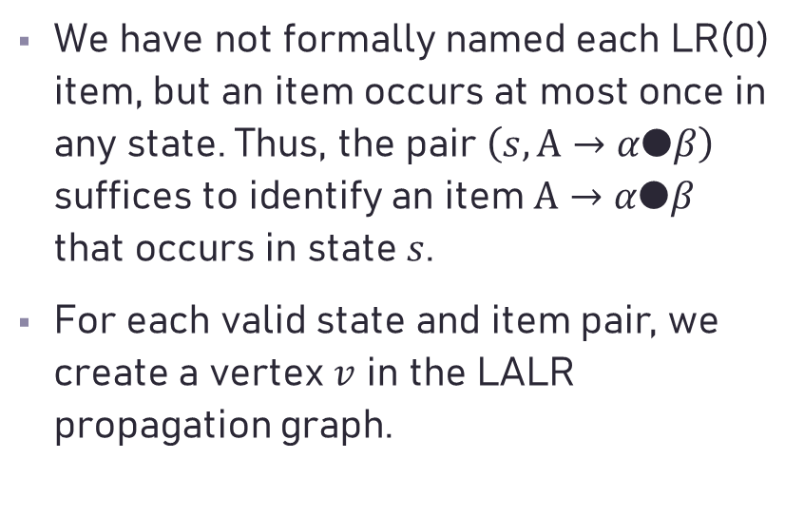
LALR Propagation Graph
We have not formally named each LR(0) item, but an item occurs at most once in any state. Thus, the pair $\left(s, A→α●β\right)$ suffices to identify an item $A→α●β$ that occurs in state $s$.
For each valid state and item pair, we create a vertex $v$ in the LALR propagation graph.

Slide 9

LALR Propagation Graph
The ItemFollow sets are initially empty, except for the augmenting item $Start→●S\$$in the LR(0) start-state.

Slide 10
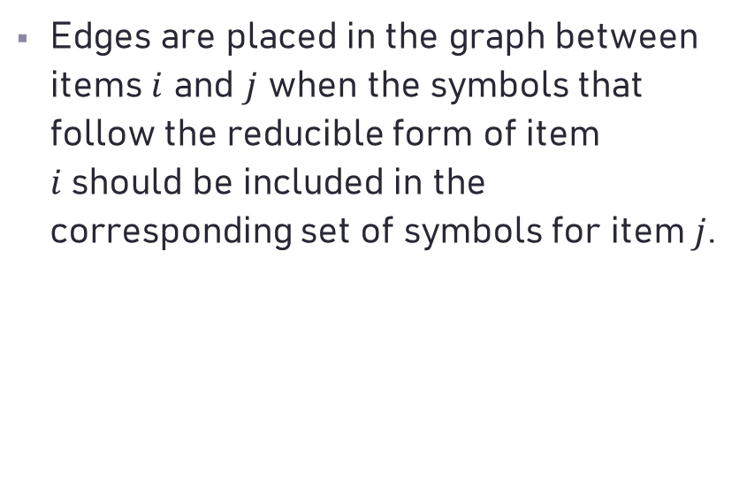
LALR Propagation Graph
Edges are placed in the graph between items $i$ and $j$ when the symbols that follow the reducible form of item $i$should be included in the corresponding set of symbols for item $j$.

Slide 11

LALR Propagation Graph
For the item $A→α●Bγ$, any symbol in $First(γ)$ can follow each closure item $B→●δ$.

Slide 12
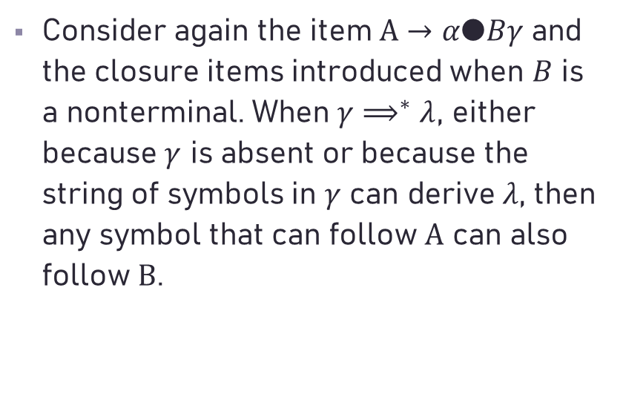
LALR Propagation Graph
Consider again the item $A→α●Bγ$ and the closure items introduced when $B$ is a nonterminal. When $γ⟹^{∗}λ$, either because $γ$ is absent or because the string of symbols in $γ$ can derive $λ$, then any symbol that can follow $A$ can also follow $B$.

Slide 13
LALR Propagation Graph

Slide 14
LALR Propagation Graph

Slide 15
LALR Propagation Graph

Slide 16
LALR Propagation Graph

Slide 17
LALR Propagation Graph

Slide 18
LALR Propagation Graph

Slide 19
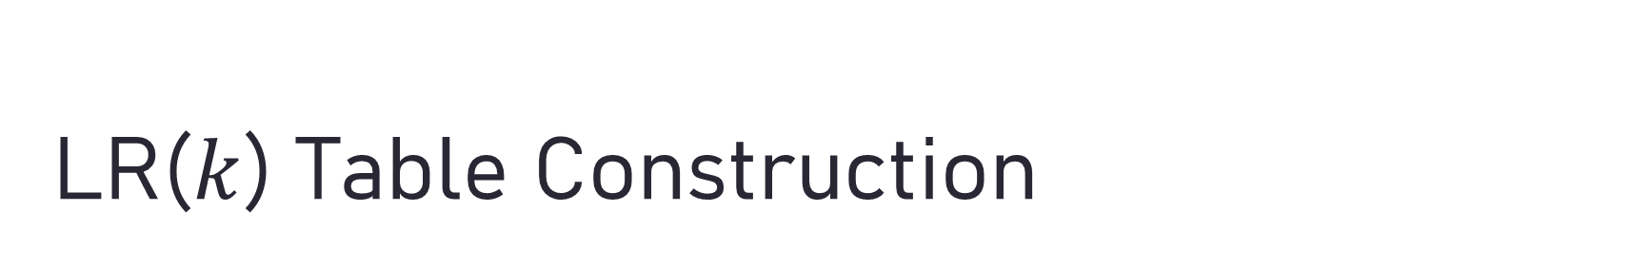
LR($k$) Table Construction
reduce /reduce conflict

Slide 20
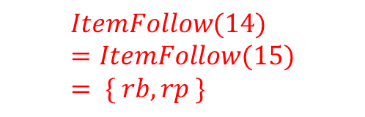
LR(𝑘) Table Construction
$$ItemFollow(14)=ItemFollow(15)= \{ rb, rp \}$$

Slide 21
LR($k$) Table Construction

Slide 22
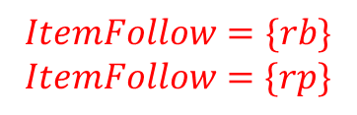
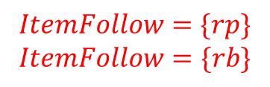
LR($k$) Table Construction
14
$$ItemFollow=\{rp\}$$
$$ItemFollow=\{rb\}$$
$$ItemFollow=\{rb\}$$
$$ItemFollow=\{rp\}$$

Slide 23
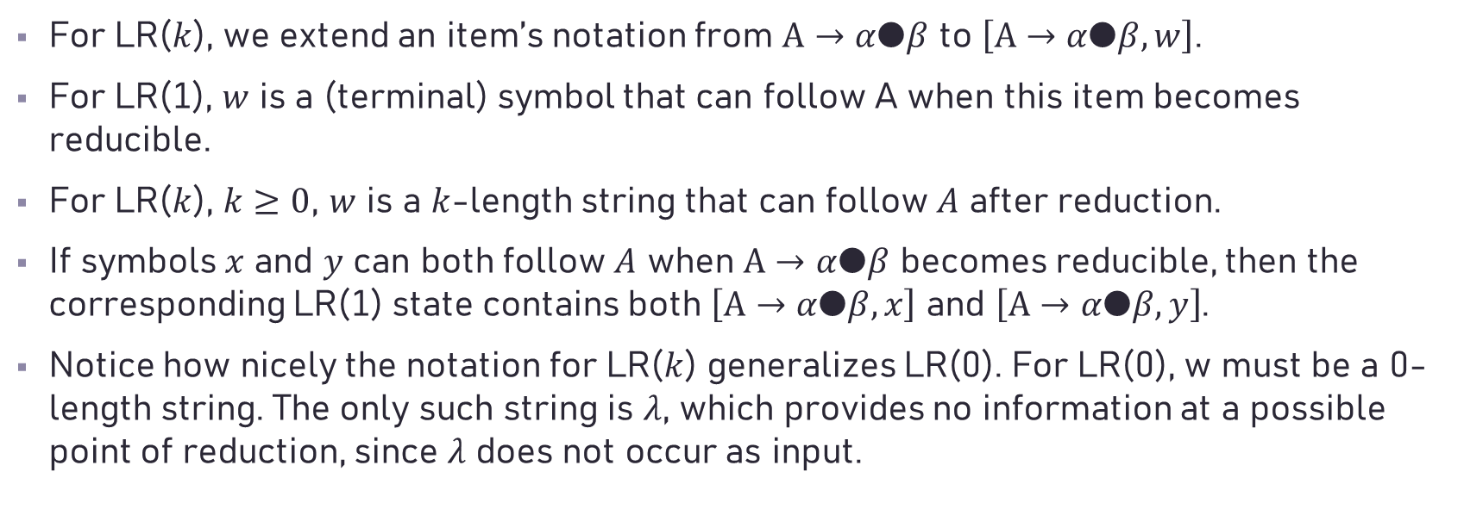
LR($k$) Table Construction
For LR($k$), we extend an item’s notation from $A→α●β$ to $\left[A→α●β, w\right]$.
For LR(1), $w$ is a (terminal) symbol that can follow A when this item becomes reducible.
For LR($k$), $k≥0$, $w$ is a $k$-length string that can follow $A$ after reduction.
If symbols $x$ and $y$ can both follow $A$ when $A→α●β$ becomes reducible, then the corresponding LR(1) state contains both $\left[A→α●β, x\right]$ and $\left[A→α●β, y\right]$.
Notice how nicely the notation for LR($k$) generalizes LR(0). For LR(0), w must be a 0-length string. The only such string is $λ$, which provides no information at a possible point of reduction, since $λ$ does not occur as input.

Slide 24
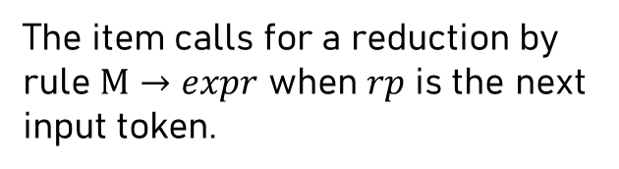
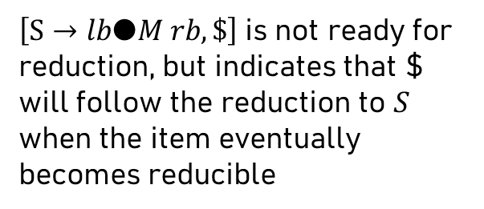
LR($k$) Table Construction
$\left[S→lb●M rb, \$\right]$is not ready for reduction, but indicates that $ will follow the reduction to $S$ when the item eventually becomes reducible
The item calls for a reduction by rule $M→expr$ when $rp$ is the next input token.

Slide 27
LR(𝑘) Table Construction

Slide 28

Exercises 27, 40, 41, 45

Slide 29
Yacc

Slide 30
Disambiguating Rules for Yacc (*required only when there exists a conflict)
1. In a shift/reduce conflict the default is to shift.
2. In a reduce/reduce conflict the default is to reduce by the earlier grammar rule in the input sequence.
3. Precedence and associativity (left, right, nonassoc) are recorded for each token that have them.

Slide 31
4. Precedence and associativity of a production rule is that (if any) of its final (rightmost) token unless a
"%prec " overrides. Then it is the token given following %prec.
5. In a shift/reduce conflict where both the grammar rule and the input (lookahead) have precedence, resolve in favor of the rule of higher precedence. In a tie, use associativity. That is, left assoc. => reduce; right assoc. => shift; nonassoc => error.
6. Otherwise use 1 and 2.
(Please See Page 238 of the Textbook)

Slide 32
Yacc
declared in "y.tab.h"

Slide 33
Yacc
The lexical analyzer yylex() produces tokens consisting of a token name and its associated attribute value. If a token name such as DIGIT is returned, the token name must be declared in the first section of the Yacc specification. The attribute value associated with a token is communicated to the parser through a Y acc-defined variable yylval.
Whenever the lexer returns a token to the parser, if the token has an associated value, the lexer must store the value in yylval before returning. In this first example, we explicitly declare yylval. In more complex parsers, yacc defines yylval as a union and puts the definition in y.tab.h.

Slide 34
Yacc
declared in "y.tab.h"
declared by yacc
A Yacc Parser
The Lexer

Slide 35
Yacc
On a UNIX system, yacc takes your grammar and creates y.tab.c, the C language parser, and y.tab.h, the include file with the token number definitions. Lex creates lex.yy.c, the C language lexer. You need only compile them together with the yacc and lex libraries. The libraries contain usable default versions of all of the supporting routines, including a main() that calls the parser yyparse() and exits.

Slide 36
Yacc

Slide 38
Yacc
The generated header file y.tab.h includes a copy of the definition so that you can use it in the lexer. Here is the y.tab.h generated from this grammar:

Slide 39
Symbol table

Slide 41
Symbol table (Lex)

